Slide 1

PROJECT REVIEW
Super Resolution Image Denoiser Network: Toward real world image denoising
Team Leader
P. Mohit Harsh (21951A04A3)
Team Members
J. Manoj Naidu (21951A04R4)
Vivek Teja Vardhan (21951A04Q8)
Vivek Vishnu Vardhan (21961A04Q9)
Team Mentor
Dr. V. Padmanabha Reddy

Slide 2
ABSTRACT
In recent years, deep learning has significantly advanced image denoising techniques, with methods such as transformers and GANs pushing the boundaries of performance. However, these state-of-the-art models are typically resource intensive, requiring vast computational power, large datasets, and extensive training time, which also hampers real-time inference speed. To address these challenges, we propose the Super Resolution Image Denoiser Network (SRIDNet), a lightweight yet highly effective model designed to achieve near state-of-the-art results with a fraction of the data and computational resources. SRIDNet significantly reduces the model size while maintaining competitive performance in image denoising and super-resolution tasks. We evaluated our model on multiple datasets, where it demonstrated high PSNR scores, and the fastest inference times compared to existing models. Our results confirm that SRIDNet offers an efficient solution for real-time image denoising, making it a practical alternative to more cumbersome models without compromising on quality.

Slide 3
LITERATURE REVIEW

Slide 4
DENOISING IMAGES USING DEEP LEARNING
With the advancement of Deep Learning techniques, it is now possible to remove real noise from images such that the denoised image will be very similar to the ground truth image with minimal loss of detail.
Over the recent years, many deep learning architectures have been developed for image denoising tasks. Among them, four state-of-the-art deep learning architectures to solve this problem are as follows:
Autoencoders (Baseline Model)
CBDNet
PRIDNet
RIDNet

Slide 5
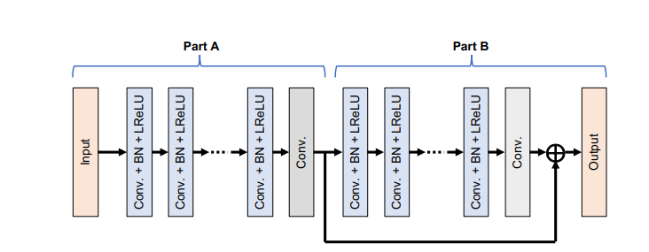
AUTO ENCODER
This is a simple encoder-decoder network with 3 convolutional layers followed by max-pooling for the encoder unit and 3 deconvolutional layers for the decoder unit.
The output from the decoder is then given to a convolutional layer with 3 filters to maintain similar input and output shape.
This is a simple architecture that will be used as a baseline model.

Slide 6
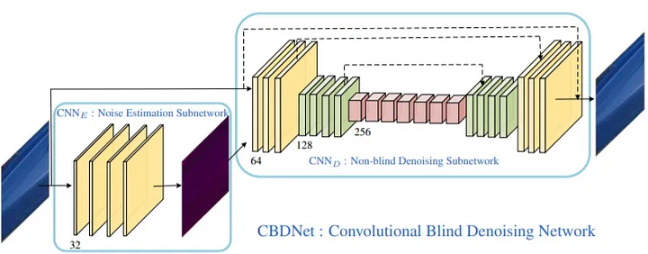
CBDNET
The CBDNet architecture comes with 2 subnetworks.
First is a noise estimation subnetwork (CNNe- estimates the noise level map in a noisy image), followed by a non-blind denoising subnetwork (CNNd- denoises the noisy image).
The network architecture is as shown.

Slide 7
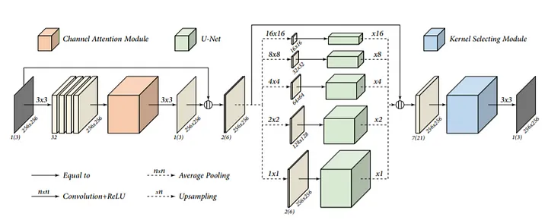
PRIDNET
The network is divided into three stages that solve three main issues that were never really addressed in many of the CNN-based denoising networks.
Channel Attention Module (CAM): add diﬀerent weightage to the channels depending upon the estimated noise level.
Five-layer pyramid module: Traditional CNN-based denoising network uses ﬁxed receptive ﬁelds which captures global information of the noise in the image but fails to capture diverse information. PRIDNet ﬁxes this issue by using diﬀerent scaled receptive ﬁelds which will also capture diverse noise information in the image. Results show that this implementation helps in denoising images that suﬀer from heavy noise.

Slide 8
PRIDNET
Kernel Selecting Module: In traditional CNN-based denoising networks, multi-scaled features are combined usually using element-wise summation or by concatenating them. This means information from diﬀerent scales is treated the same which fails to express multi-scaled features adaptively. To prevent this, PRIDNet introduced a kernel selecting module which uses diﬀerent sized kernels for each channel of the concatenated multi-scaled features.

Slide 9
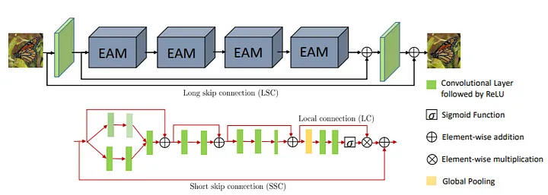
RIDNet — Residual Image Denoising Network
This network is composed of three main modules as follows :
Feature Extraction Module: It is composed of only one convolutional layer to extract initial features from the noisy input. 64 filters with kernel size=3 are used for the convolutional layer.
Feature Learning Residual on Residual Module: It is composed of a network called Enhancement Attention Modules (EAM) that uses a residual on the residual structure with local skip and short skip connections. The initial part of EAM uses wide receptive fields through kernel dilation and branched convolutions thereby capturing global and diverse information from the input image.

Slide 10
RIDNet — Residual Image Denoising Network
This network is composed of three main modules as follows :
Additional features are learned using a residual block of two convolutions followed by an enhanced residual block (ERB) of three convolutions. Finally, it is given to a feature attention block that gives more weight to the important features.
Reconstruction Module: The output of the final EAM block is given to the reconstruction module which is again composed of only 1 convolutional layer that gives the denoised image as output.

Slide 11
PROBLEM STATEMENT
Current state of the art models have been implemented using Transformer and Generative Adversarial Neural Network (GAN) concepts which have high hardware requirements and also require large amounts of data to train. Although they perform very well in controlled lab environment, they are not useful in many real life applications.
PROPOSED METHOD
To tackle the aforementioned problems, we designed a Super Resolution Image Denoiser Network (SRIDNet) that demonstrates a favorable balance between performance and efficiency. It delivers competitive denoising results while maintaining a small model size and low computational cost, making it highly suitable for resource- constrained environments.

Slide 12
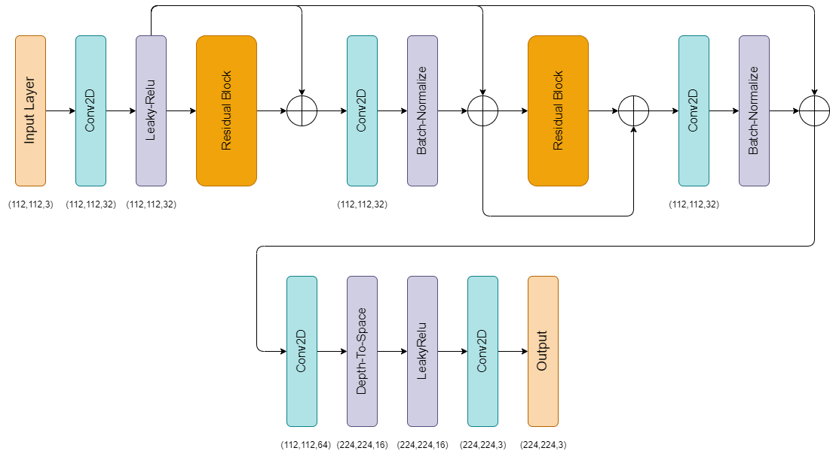
SUPER RESOLUTION ARCHITECTURE
Output Shape: (224, 224, 3)
Trainable Parameters: 110,515
The Super-Resolution Block is responsible for upscaling the input image from (112 × 112) to (224 × 224) by leveraging a series of convolutional layers and residual connections. This block effectively doubles the spatial resolution of the image and forms the encoder part of the architecture.

Slide 13
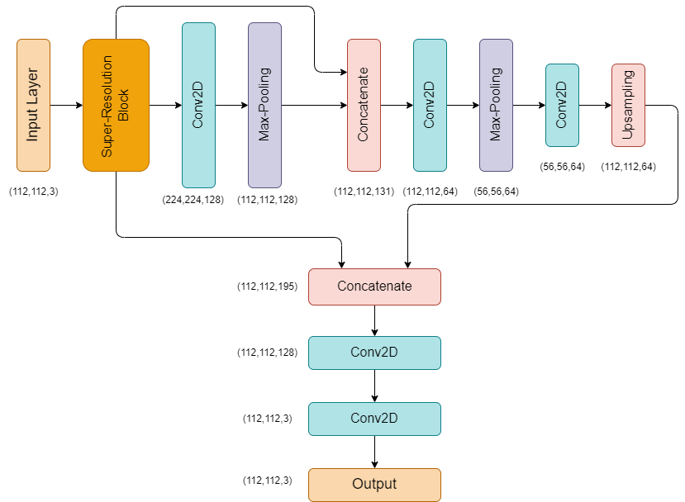
DENOISER ARCHITECTURE
Output Shape: (112, 112, 3)
Trainable Parameters: 344,259
The Denoiser Block performs the task of noise removal by processing the upscaled image from the Super-Resolution Block. This component can be considered a decoder block, reducing the resolution back to (112 × 112) while preserving important visual features through skip connections and convolution operations.

Slide 14
THANK YOU

